Slide 1
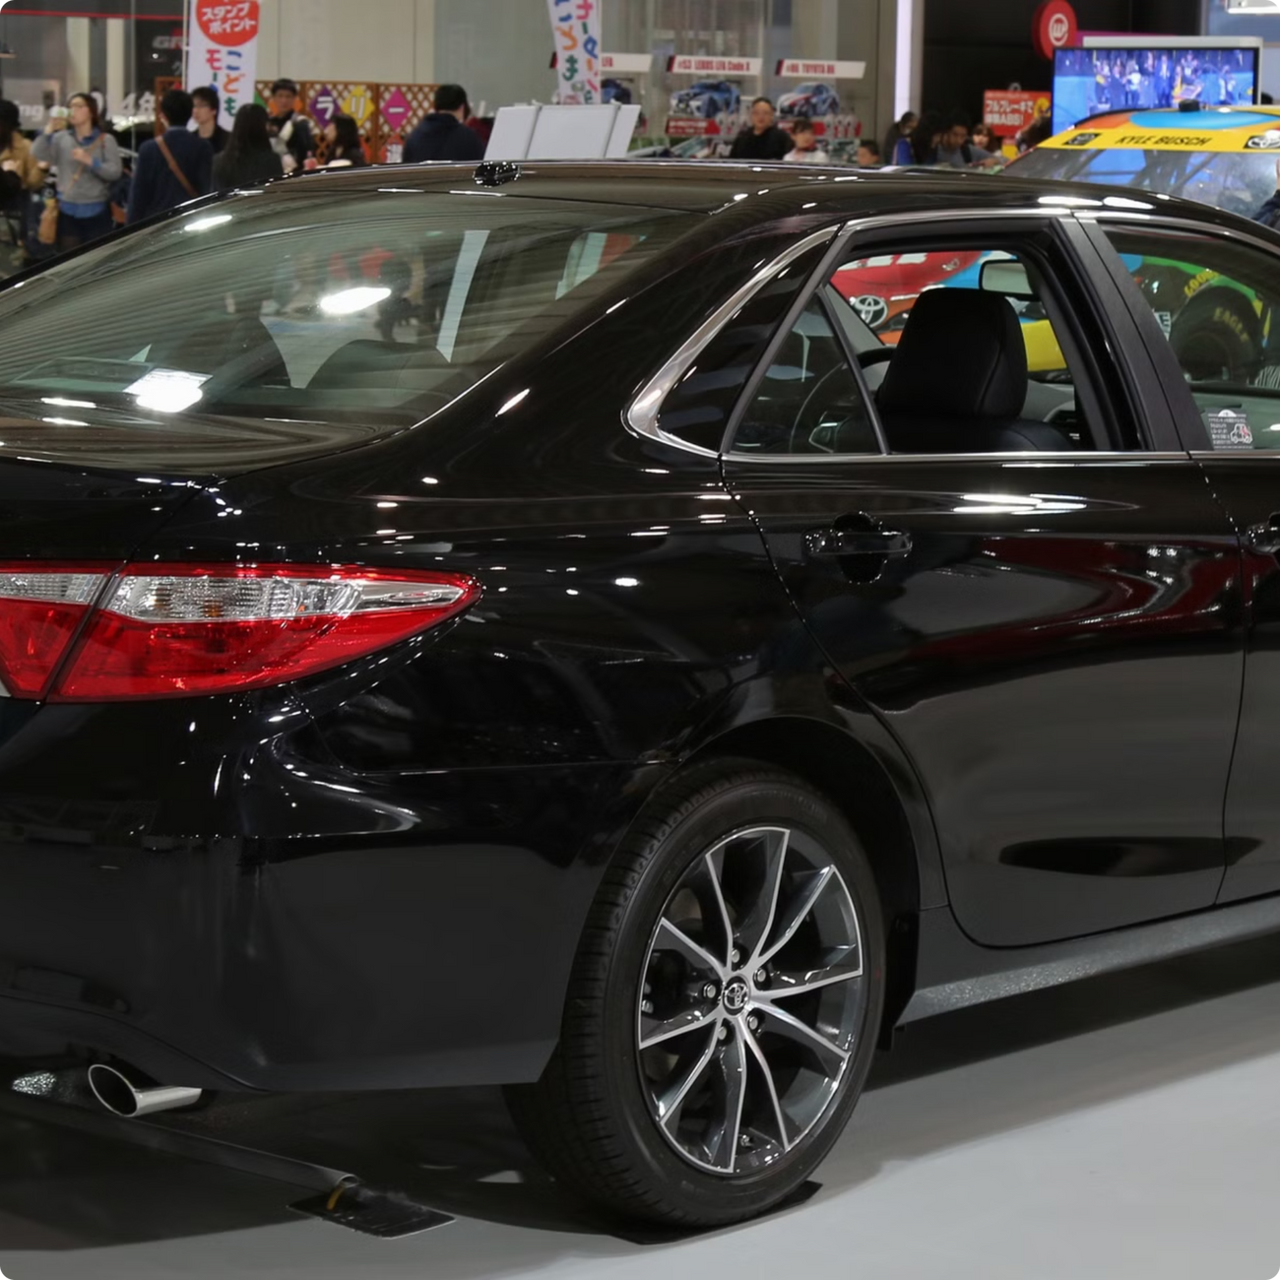

Comprehensive Analysis of Car Sales in Nigeria
Insights from 2,000+ Listings via Web Scraping & Data Analytics
Muhammad Muhsin Muhammad
Notes:
1

Slide 2
Agenda
This presentation covers the project's objectives, methodology, key data insights, recommendations for relevant stakeholders in Nigeria online car market.
1
Project Overview & Objectives
2
Methodology: Web Scraping to Insights
3
Key Data Insights
4
Recommendations for Stakeholders
Notes:
2

Slide 3
Project Overview
Client: AutoInsight Nigeria Ltd.
Objective: Analyze 2,000+ car listings for trends in pricing, brands, and preferences.
Importance: Data-driven decisions for manufacturers and dealerships.
Notes:
3

Slide 4





Methodology
Data Collection
The data will be sourced from cars45.com or other similar platforms. Key features include brand, model, year, price, mileage, condition, and color.
Data Cleaning and Exploration
Using Python with libraries like BeautifulSoup and Pandas or Excel for convenience. Cleaning and exploring the dataset through various analysis techniques.
Exploratory Data Analysis (EDA)
Visualizing data to uncover insights like price distribution, popular brands, mileage vs. price relationship, and vehicle conditions.
Detailed Analysis
Looking into regional differences, color preferences, top-selling models by brand, and the impact of manufacturing year on pricing.
Documenting and Recommendations
Documenting challenges and limitations encountered. Providing recommendations based on comprehensive analysis of car sales data in Nigeria.
Notes:
4

Slide 5
Dataset Snapshot
2,609
Toyota dominates
Most cars are locally used
Car listings
About 40% of listings
80%
Prices average around ₦13M
Cars range from 1984 to 2025 models
Most listings are from Lagos State
Median at ₦7.7M
Data includes info about
Price, brand, model, year, condition, location, color, and mileage
Notes:
5

Slide 6
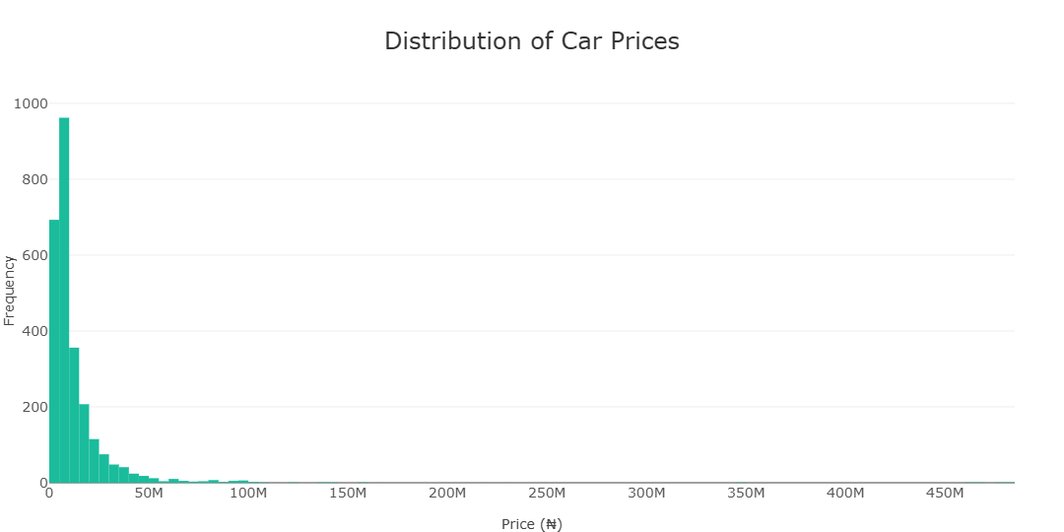
Key Insight 1 – Price Distribution
Highly right-skewed with most cars priced below ₦20M
Several high-end outliers above ₦100M
Notes:
6

Slide 7
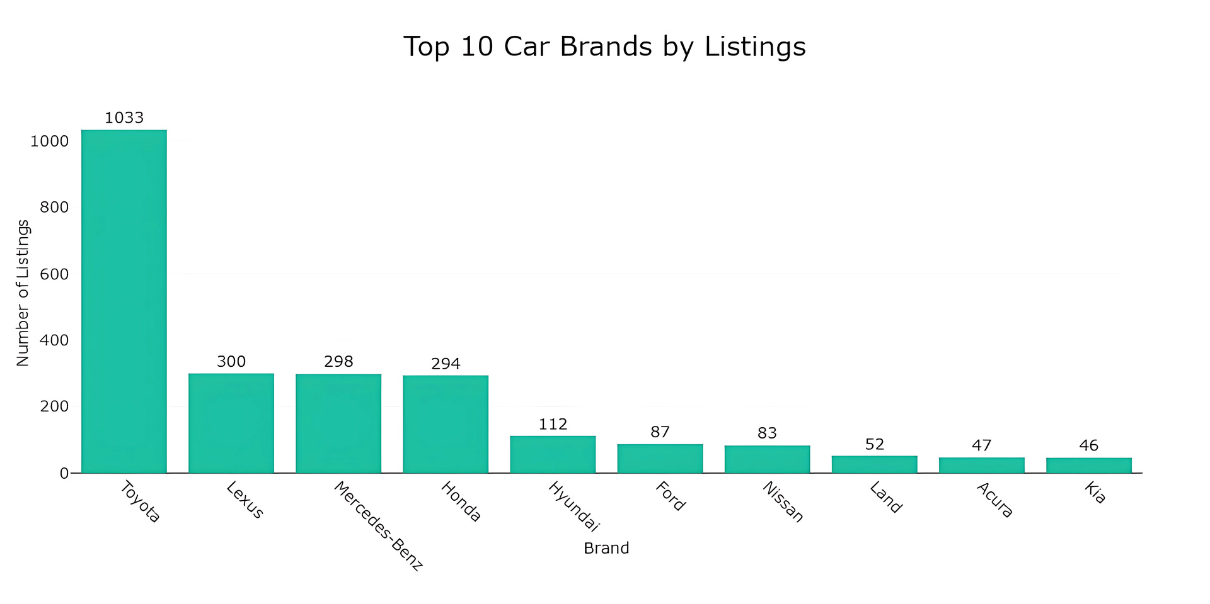
Key Insight 2 – Popular Brands
Toyota: 1,033 listings (39.7%)
Mercedes-Benz: 300 listings (11.5%)
Lexus: 297 listings (11.4%)
Honda: 288 listings (11.1%)
Hyundai: 111 listings (4.3%)
Notes:
7

Slide 8
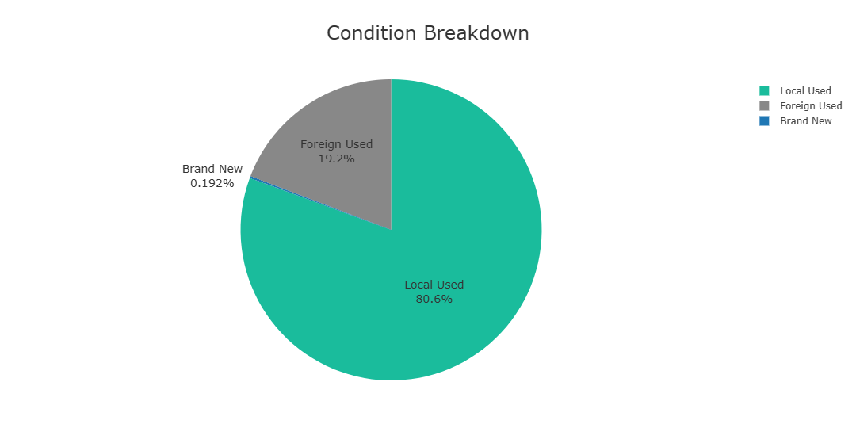
Key Insight 4 – Condition Breakdown
Local Used Car Market
Foreign Used Car Market
Brand New Car Market
The Nigerian car market is dominated by locally used vehicles, with 80.6% of car listings belonging to this category.
The Nigerian car market is dominated by used vehicles, only 19.2% being foreign used.
The data also reveals that new cars make up only 0.192% of the total listings, indicating a relatively small share of the overall market.
Notes:
8

Slide 9
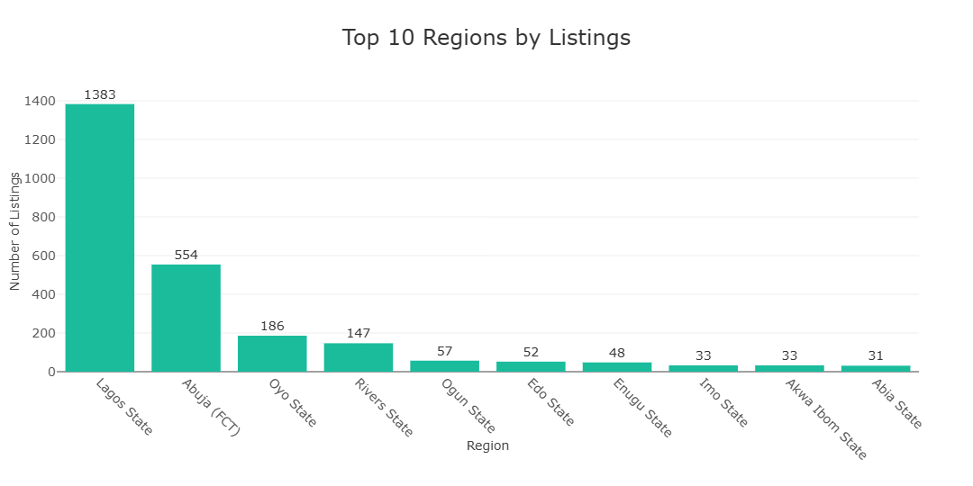
Regional Analysis
Hotspots of Car Listings
The data reveals that the car sales market in Nigeria is centered around a few key regions:
1
Lagos (30%)
Rivers (18%)
Oyo (12%)
Abuja (10%)
2
3
4
Notes:
9

Slide 10
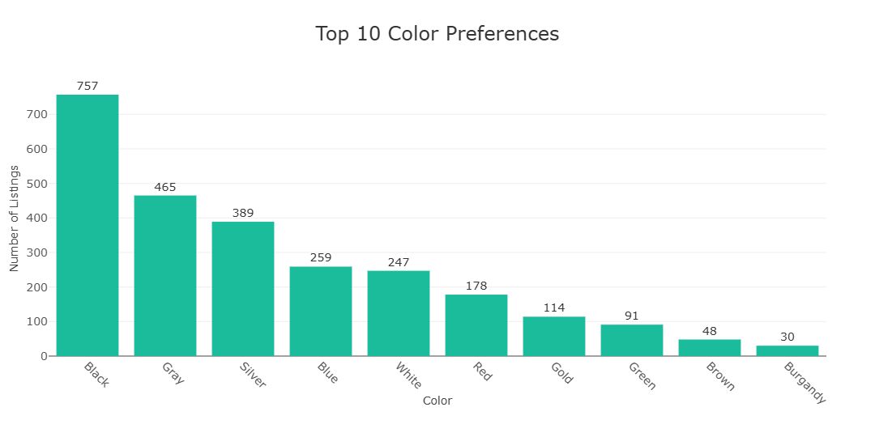
Color Preferences
Black, Gray, and Silver colors account for 62% of all cars
Neutral colors align with practicality and resale value.
Notes:
10

Slide 11
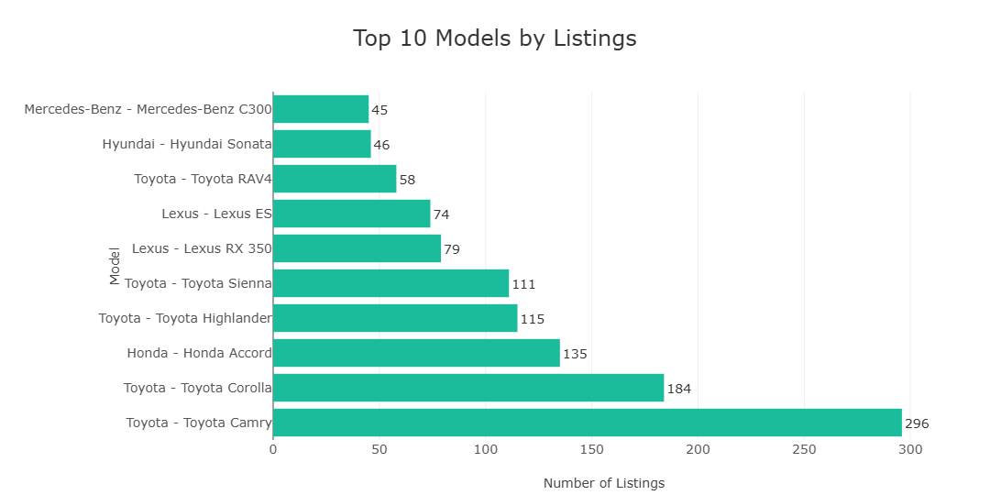
Top Models by Brand
Toyota Camry: 296 units, avg price ₦8,537,044
Toyota Corolla: 192 units, avg price ₦8,201,856
Honda Accord: 133 units, avg price ₦7,189,049
Toyota Highlander: 112 units, avg price ₦20,183,942
Toyota Sienna: 109 units, avg price ₦8,700,890
Notes:
11

Slide 12
Challenges & Limitations
Inconsistent data formatting on website.
Limited new car listings.
Mitigation: Manual validation and outlier removal.
Notes:
12

Slide 13
Recommendations (Buyers)
For buyers in the Nigerian car market, the data reveals distinct trends based on budget ranges.
For the budget-conscious buyers, those with a budget under ₦10 million, the data shows a strong presence of Toyota, Honda, and Lexus options. Toyota leads the pack with 683 options at an average price of ₦5,904,244, followed by Honda with 225 options at an average of ₦4,577,947, and Lexus with 153 options at an average of ₦6,889,428.
In the mid-range budget category, between ₦10 million and ₦25 million, Toyota continues to dominate with 269 options at an average price of ₦15,092,026. Mercedes-Benz and Lexus also feature prominently in this segment, with 116 options at an average of ₦16,149,470 and 83 options at an average of ₦16,783,196, respectively.
Notes:
13

Slide 14
Recommendations (Sellers)
For Sellers, the data provides valuable insights into the most liquid markets and best performing segments in the Nigerian car market.
Looking at the most liquid markets, Lagos State leads the pack with 1,384 active listings and an average model year of 2009, Abuja (FCT) follows closely with 550 active listings and an average model year of 2009 also, Lastly, Oyo State rounds out the top three with 181 active listings and an average model year of 2007.
When it comes to the best performing segments, the data highlights some interesting trends. In the Land Rover (Foreign Used) category, the average price stands at a remarkable ₦43,731,146, with 12 units Listed. The Lexus (Foreign Used) segment also performs exceptionally well, with an average price of ₦42,113,831 and 65 units Listed. Finally, the BMW (Foreign Used) segment boasts an average price of ₦38,762,500, with 6 units Listed.
Notes:
14

Slide 15
Conclusion
Key findings: Nigerian car market is mature with regional price variations. Lagos dominates listings (50%), Toyota leads brand share (40%). Foreign-used vehicles command premiums.
This comprehensive analysis of Cars45.com's Nigerian market data reveals a mature, segmented market with clear opportunities for both buyers and sellers. The market shows strong regional variation in prices, with significant arbitrage opportunities between regions. Lagos State dominates with over 50% of listings, while Toyota leads brand presence with nearly 40% market share.
The data shows three distinct price segments, with foreign-used vehicles commanding significant premiums over local-used ones. This analysis provides actionable insights for market participants, identifying optimal buying locations by brand and highlighting the most liquid market segments for sellers.
Notes:
16

